Slide 1

Forage Virtual Data Science Internship
Web scraping to gain company insights
04/09/2023

Slide 2
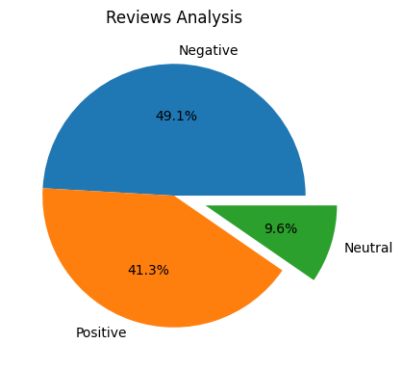
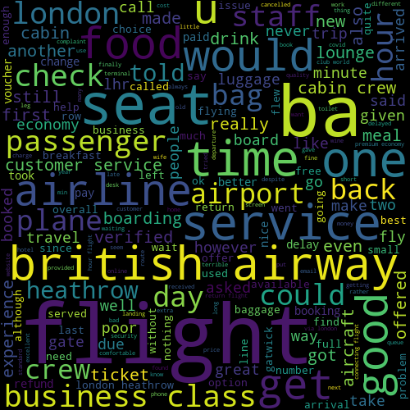
Collected and cleaned 1000 reviews given by customers, I obtained
Positive Reviews
413
Negative Reviews
491
Neutral Reviews
96

